Slide 1

Chapter 6: Fig 6.38 Subroutine with Array parameter

Slide 2
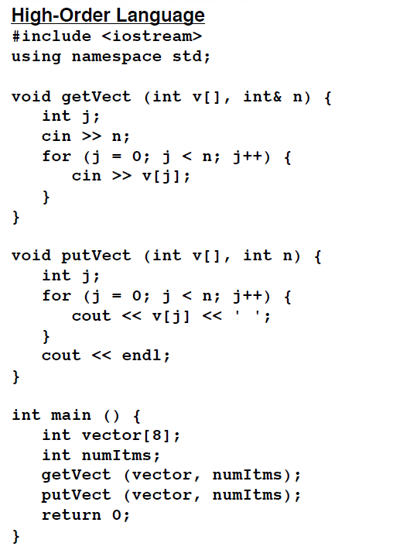
A procedure call with an array parameter at Level HOL6 and Level Asmb5 fig. 6.38

Slide 3
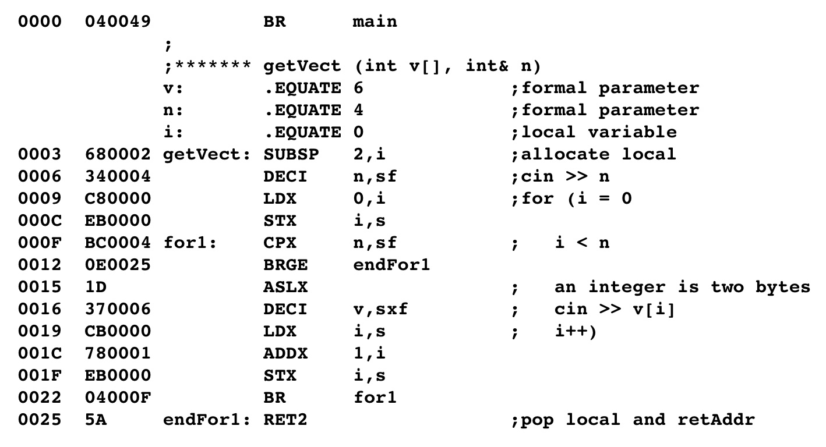
A procedure call with an array parameter at Level HOL6 and Level Asmb5
Input the value using stack-relative
deferred addressing since n is a
Pass-by-reference parameter.
initialize i using stack-relative
Since i is a local variable.
Test the loop using the relative
variable n (stack-relative
deferred addressing since n is
a pass-by-reference parameter)
Double the index for int's
Create the local variable
Input using stack-indexed
deferred addressing.
Increment the local variable
i (which is stored in the index
register).

Slide 4
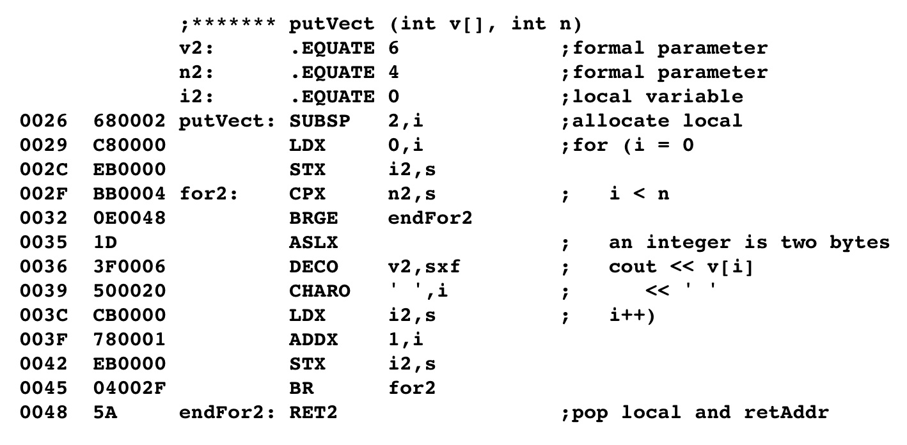
A procedure call with an array parameter at Level HOL6 and Level Asmb5

Slide 5
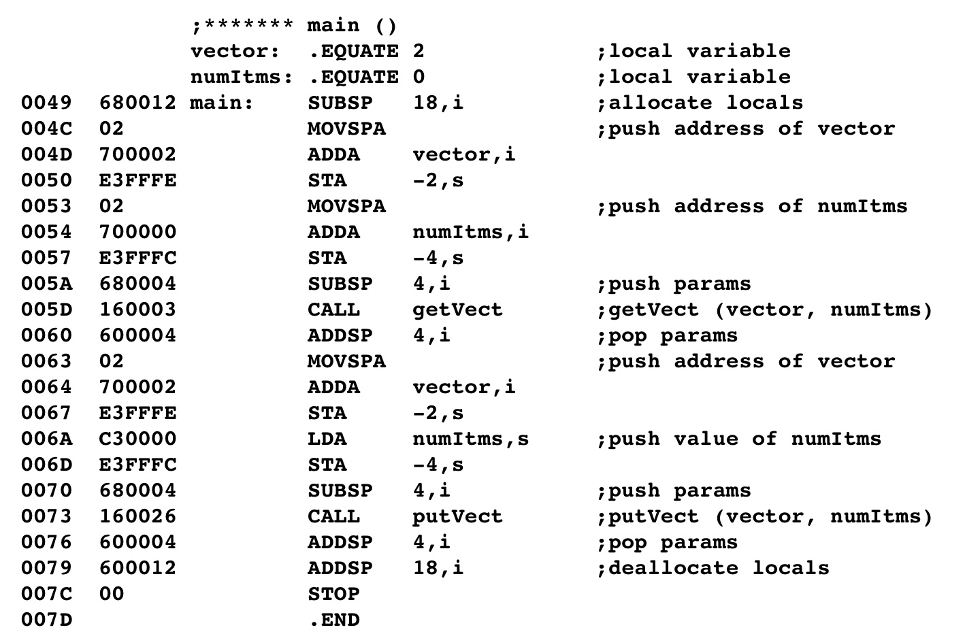
A procedure call with an array parameter at Level HOL6 and Level Asmb5
Load the address of the first
element of the array onto the
stack. Note that this is the
address of the array name.
Move the address of the second
parameter onto the stack.
Change the top of the run time stack
Create the array
Pop off the parameters
Push parameters for next procedure
call

Slide 6
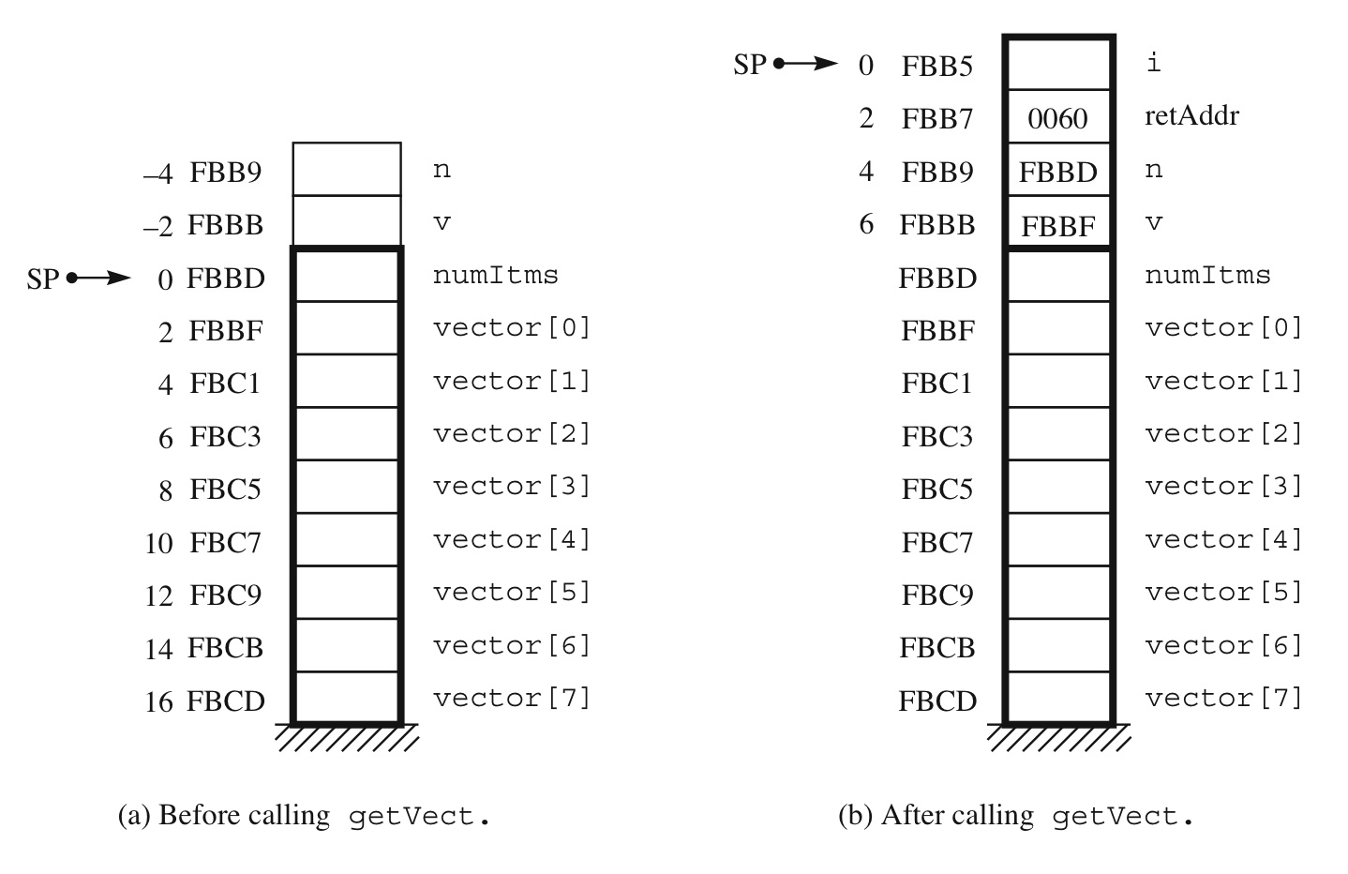
Arrays as parameters

